Slide 1
Project 1 Group 1
Chase Arnett, Jordan Graves, Shanice Cummings, Jonathan Lockridge
10/23/24

Slide 2
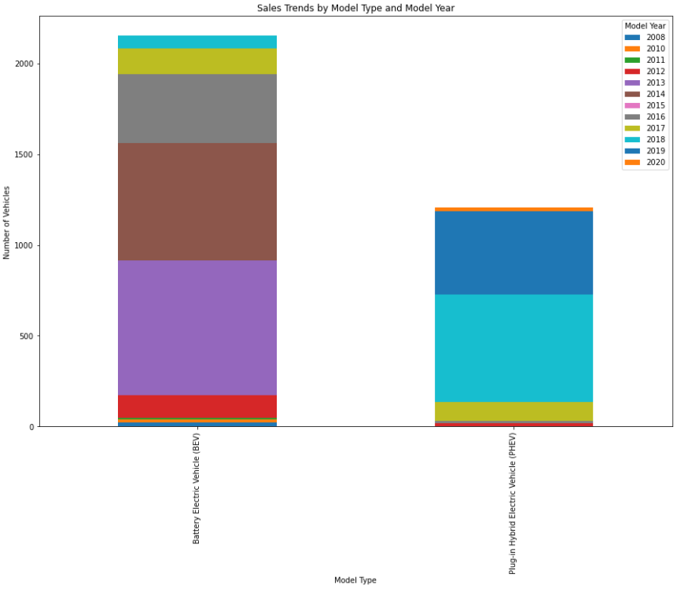
Based on the 2020 Census tract, more BEV’s have been purchased over 12 years than PHEV.
BEV
PHEV
2013, 2014, and 2016 are the greatest Model Years sold.
BEV has more sold vehicles.
PHEV sold 1300 vehicles in 12 years.
2018 and 2019 are the top two Sale years.

Slide 3
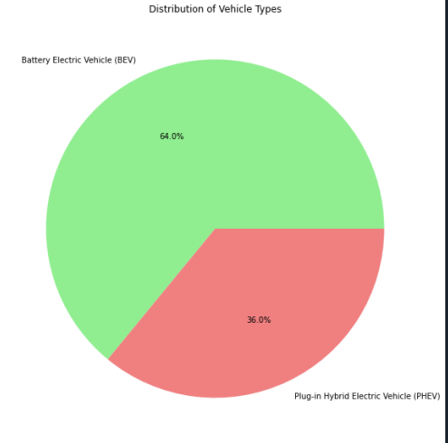
The Census data concluded that by year 2020 64% of sales in WA are BEV.
Only 34% are PHEV.

Slide 4
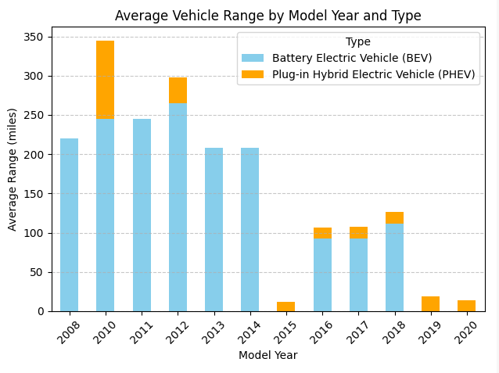
BEV has longer range than PHEV.
2012 has the top Range in BEV class.
PHEV with limited range, had greater sales in 2010.

Slide 5
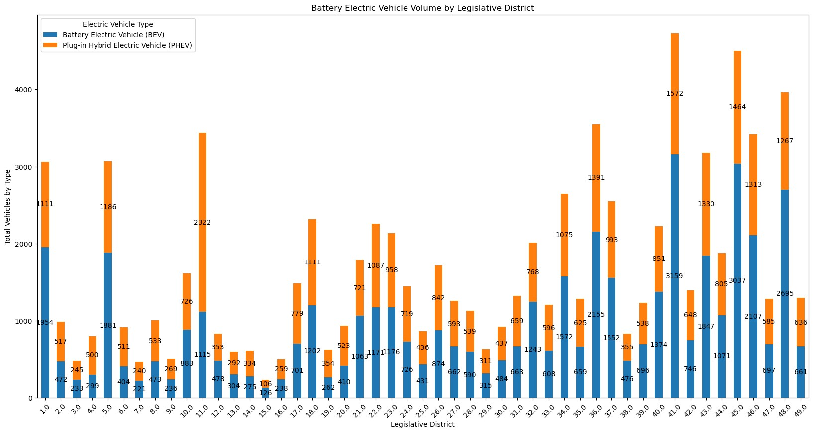
Analysis of Legislative Districts

Slide 6
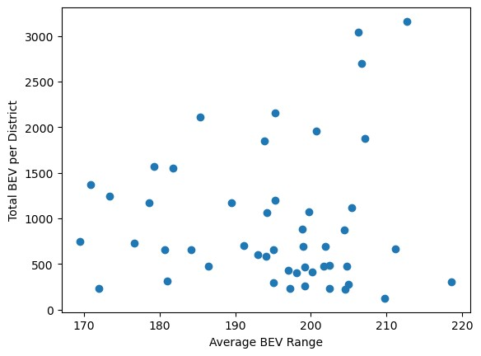
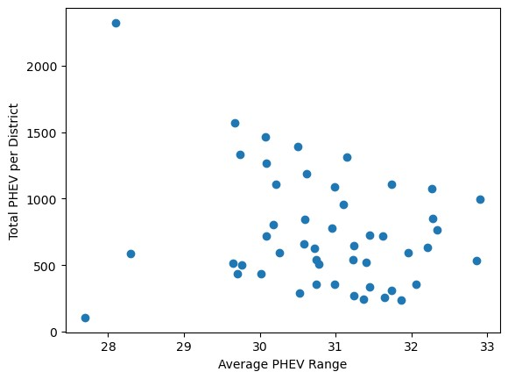
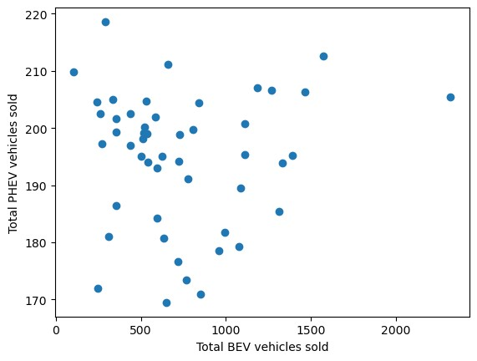
Correlation of Various Comparisons –Legislative District
Average Range between BEV and total Sales in each district
Average Range between PHEV and total Sales in each district
Total sales of BEV to PHEV in each district
Correlation for each comparison is <.05. We can conclude that there is no correlation between PHEV and BEV sales in the legislative districts in Washington state.

